Slide 1
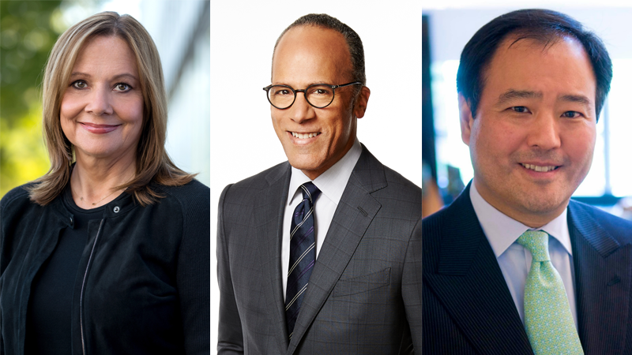
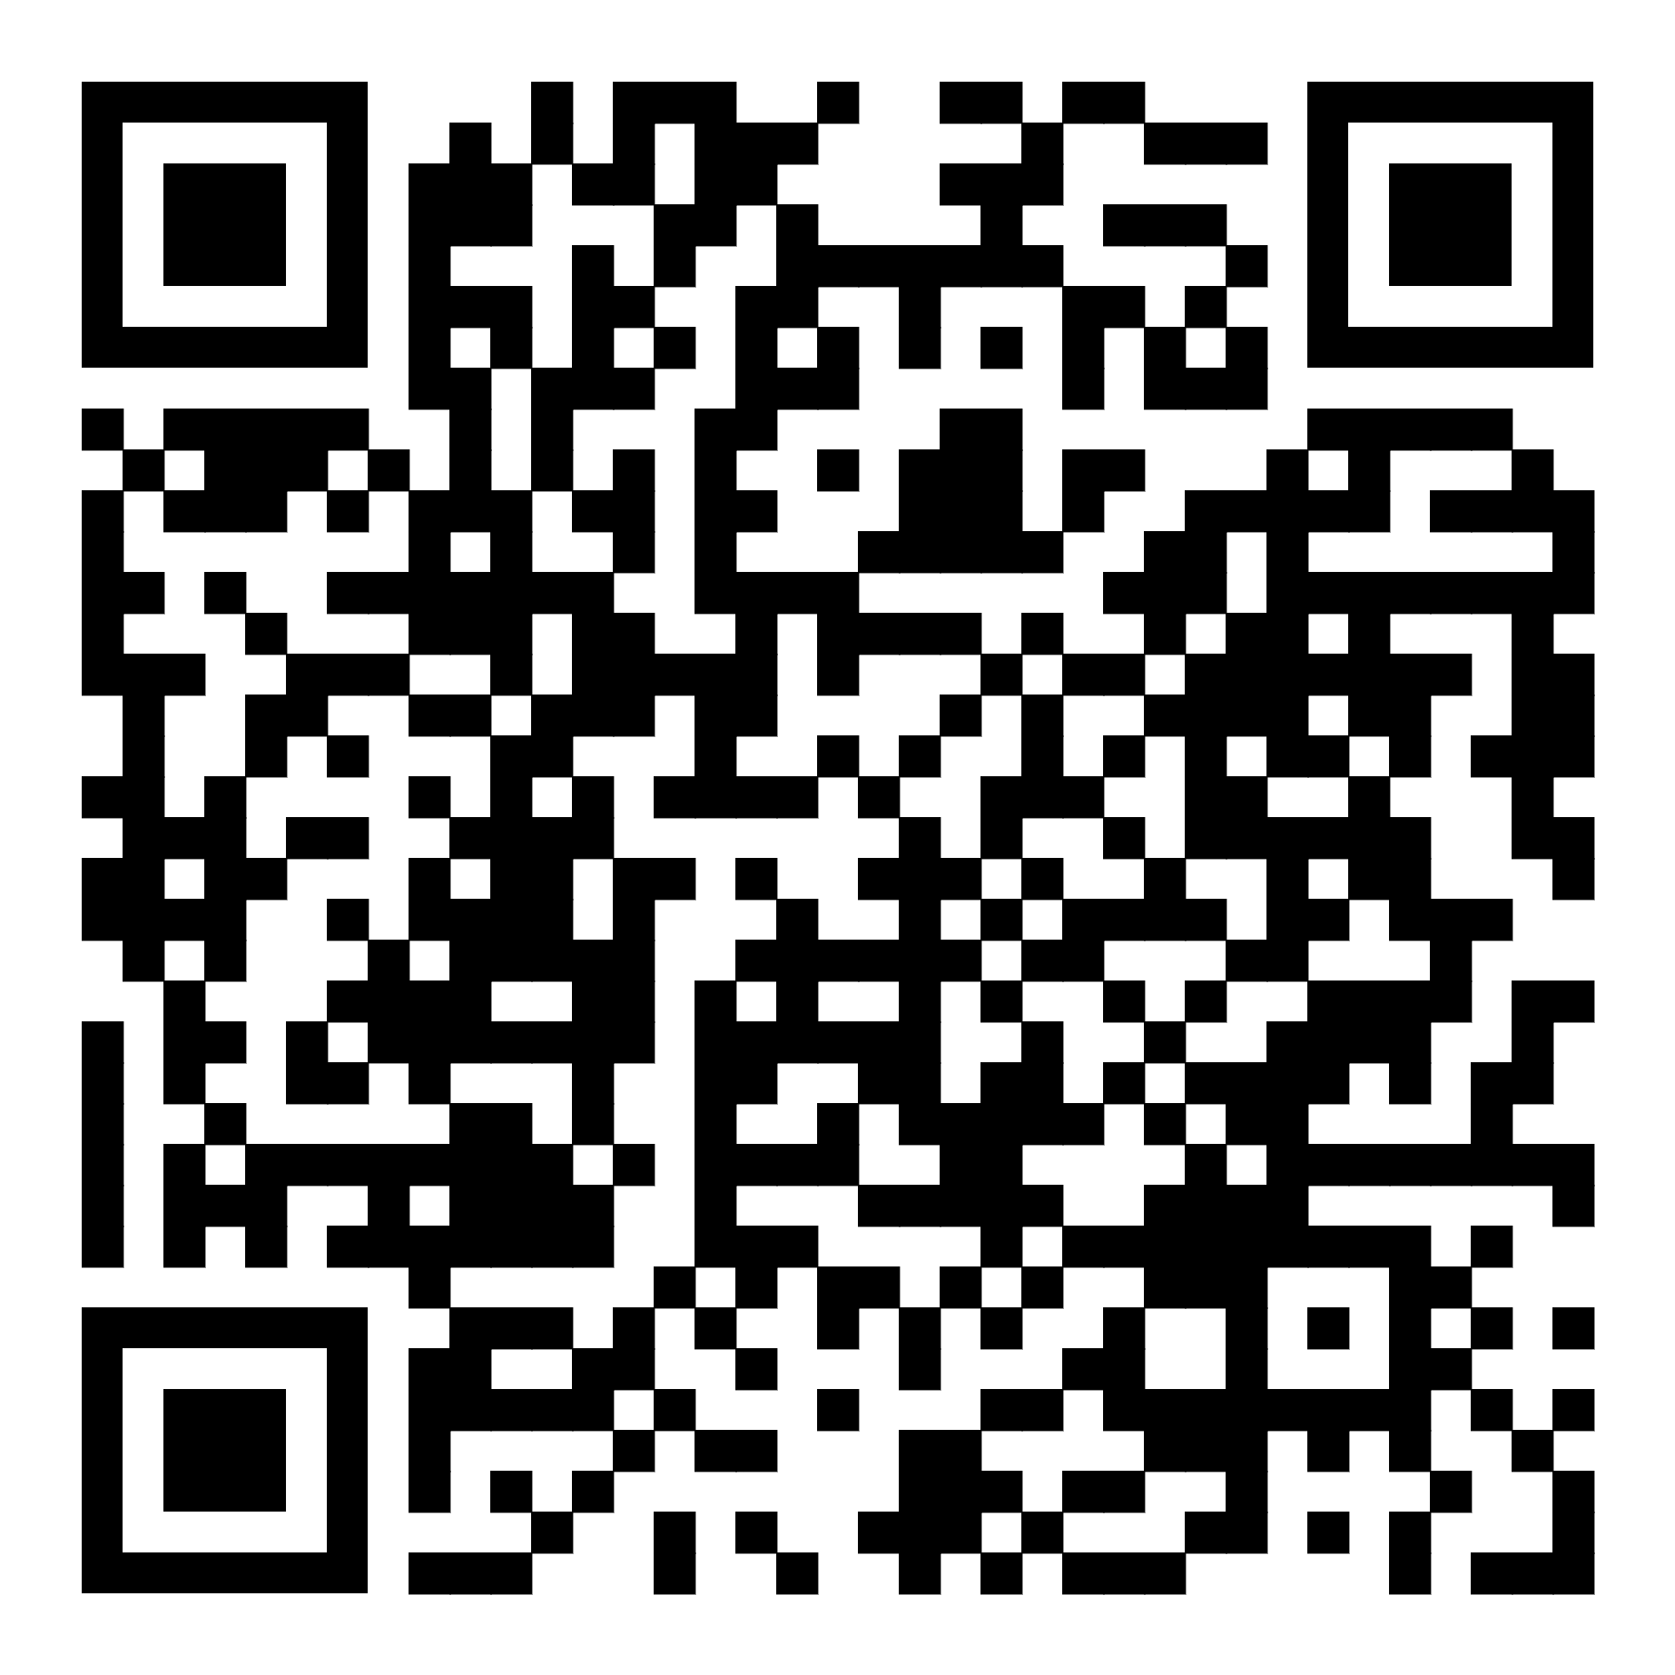
STUDENT ESSAY CONTEST
The 7th annual Page Center Awards will be
live-streamed at 7 p.m. ET on Feb. 22, 2023.
awards.thepagecenter.org | #PageCenterAwards
HOW IT WORKS:
Register for the 2023 Page Center Awards.
Attend the virtual event on Feb. 22.
Choose one of the three honorees
Honorees will share remarks and participate in a Q&A session at the event.
Write and submit an essay (300-350 words) about the event and the honoree with a reflection on the honoree’s segment.
Mary Barra, CEO, General Motors
Lester Holt, Anchor/managing editor, NBC
Jon Iwata, Former chief brand officer, IBM
Visit the awards site for more details:
awards.thepagecenter.org.
Winners will receive a $250 prize and winning essays will be shared with honorees

