Slide 1

Welcome…..
Internship Information
Session
bellisario.psu.edu • Internships and Career Services

Slide 2

Where are we located?
Virtual/208 Carnegie
bellisario.psu.edu • Internships and Career Services

Slide 3
Topics To Be Covered
3 C’s to Success
Why Internships?
Internship options
Internship Application Process
Strategy to search for internships
Internship database
How to get an Internship location approved
Requirements for COMM 495
Overview of the Internship Packet
Additional Resources
bellisario.psu.edu • Internships and Career Services

Slide 4
3 C’s to Success
Academic Coursework
Get Involved in Campus activities and organizations
Prepare for your Career by doing Internships, Internships,
Internships
bellisario.psu.edu • Internships and Career Services

Slide 5














Why do you NEED an internship?
It’s your chance to gain hands-on skills in a professional setting
To acquire valuable work experience
To ensure that you are marketable upon graduation
To narrow your field of interest
You need experience and focus to get a job
To learn how to effectively develop a search for the internship that best suits your needs. These skills are transferable to your future career search.
bellisario.psu.edu • Internships and Career Services

Slide 6
Like to take an Internship?
Three main types of internships
  Paid: gain experience and get paid
  Volunteer: gain experience, not paid and not earning credit
  Internships for Credit
Bellisario College students are eligible to earn up to 6 credits during their undergraduate careers
  Individual internships can be done for 1, 2 or 3 credits
You can complete internships in all semesters: fall, spring and summer!
bellisario.psu.edu • Internships and Career Services

Slide 7
First-Year Students: Are you eligible to take an internship?
As a first-year, you may not be eligible to take an internship for-credit; however, you can take an internship for experience.
If you want to take an internship for-credit or it is required, you must do the following:
  Speak to your adviser before you pursue an internship for-credit.
  Document your previous experience relating to the specific internship.
  Obtain a letter from your potential supervisor stating they are aware you have not had the pre-requisite course, but they are willing to accept you as an intern.
bellisario.psu.edu • Internships and Career Services

Slide 8
Taking an Internship for Experience:
PAID or NO CREDIT
The Bellisario College of Communications has no jurisdiction over your paid or non-credit internship. The College is not involved in the internship process other than helping you find prospective internship opportunities.
The internship locations you have chosen must agree to have you intern for NO CREDIT.
If the internship location agrees to have you as an intern for NO CREDIT, then you only need to adhere to the requirements set by the internship location.
You are NOT required by the Bellisario College to complete any assignments when taking a paid internship, or one strictly for experience.
You can be PAID and do an internship for credit.
bellisario.psu.edu • Internships and Career Services

Slide 9
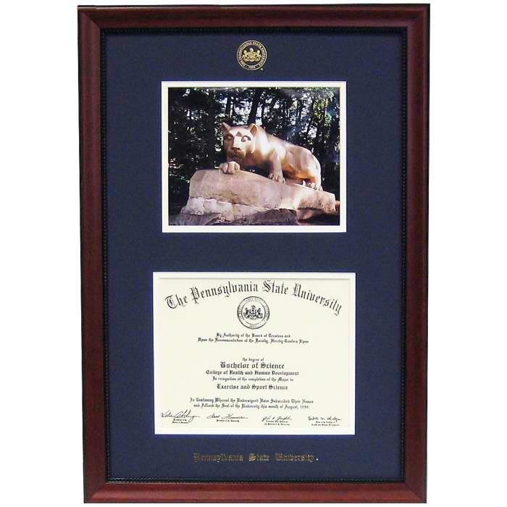
2 Reasons why you would take an Internship for credit:
The Internship location requires you to take the internship for-credit. In this case, if you want to do this internship, you MUST do it for credit.
These credits count towards your degree progress and may replace a class for you.
bellisario.psu.edu • Internships and Career Services

Slide 10
Degree Requirement?
It is NOT a Bellisario College of Communications degree requirement to do an internship of any kind, including an internship for-credit, however:
Many locations dictate you must earn academic credit while completing the internship experience.
bellisario.psu.edu • Internships and Career Services

Slide 11
Internship Application for-Credit
Complete the Bellisario College of Communications Internship for-Credit Application online
Write a 5-sentence statement about why you want to take an internship for-credit
Attach your resume
Submit all three items for APPROVAL to the Internships and Career Placement Office- electronically
This is not a binding document, nor is it attached to a particular internship, it approves YOU to do an internship during that semester
bellisario.psu.edu • Internships and Career Services

Slide 12
COMM 495: Internship for Credit
Pay per credit (unless you are a full-time student during the semester of the internship)
Must register for the course
Must complete assignments
Receive a grade that goes towards your G.P.A. for the amount of credits you have taken.
Only exception: you do not go to a classroom…..you go to your internship location.
bellisario.psu.edu • Internships and Career Services

Slide 13
Use your 6 credits wisely!
Even if the internship location requires you to do it for credit, YOU get to choose how many credits-1, 2 or 3 credits. This is different for everyone
  1 credit = 67 hours
  2 credits = 134 hours
  3 credits = 201 hours
Example: Joe Smith is a Junior in Telecom
1st Internship – will intern @ QWK Rock during Spring for 2 credits
2nd Internship – will intern @ Howard Stern Show during the summer for 3 credits
3rd Internship will intern @ Verizon during the Fall for 1 credit
Total credits used = 6 credits
bellisario.psu.edu • Internships and Career Services

Slide 14
Where do Bellisario College of Communications students go to find internship opportunities?
The Bellisario College of Communications has developed a database of more than 4,600 registered internship locations.
Internship locations not found through our database must be approved as a registered internship location with the Bellisario College of Communications.
It is our mission to only accept internship locations that will provide a viable learning experience and a nurturing environment for you to perform the job in the career field you have chosen.
This ever-growing list includes every type of communications organization from high profile companies to cutting edge technology companies, from premiere broadcast journalism organizations to highly respected advertising agencies and public relations firms.
bellisario.psu.edu • Internships and Career Services

Slide 15
Internship Search Strategy
The first factor in your search strategy is GEOGRAPHY- where do you plan on interning?
From there, we recommend you generate a list of 15-25, leads/profiles
Start with the internship database for the search
Use other industry-specific sources to expand your search, including: teamworkonline.com, Ed2010.com, radio-locator.com, tvwebdirectory.com
Maximize your own personal network- family, friends, neighbors- TALK to them!
** Biggest factor- Visit us! We will walk you through this search in-person or via zoom and show you your leads!
Follow our PRQCAR method- profile, research, ask questions, call, apply, recall!
bellisario.psu.edu • Internships and Career Services

Slide 16
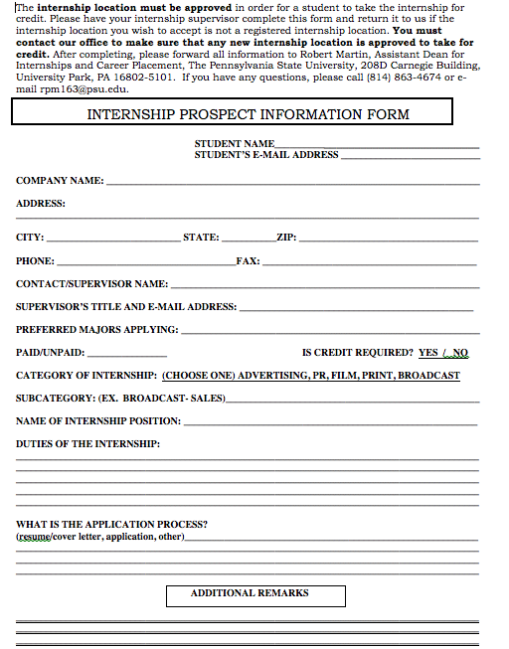
New Spot? Get it approved!
Online application will ask if the site is approved- play it safe and say no, then complete the prospect form!
The location must be APPROVED before you begin your internship
It is your obligation to find out if the internship location has been approved.
We always like to learn of new opportunities for our students!
bellisario.psu.edu • Internships and Career Services

Slide 17
Internships for credit- COMM 495
The bulk of your work is at the internship site
We have assignments for you to complete in order to earn a letter grade, and the internship site may have additional requirements.
Once you are approved, you must schedule COMM 495 in Lionpath (or our office) for 1, 2 or 3 credits. Make sure you can fulfill the MINIMUM number of hours for that credit level- talk to your supervisor!
Once you schedule, the course packet for that semester will become active in your CANVAS account. READ the entire packet, it outlines all course requirements for the semester.
Start logging your hours, keeping your journals and absorbing as much as you can while you’re at this location
Follow the timeline for assignment due dates!
bellisario.psu.edu • Internships and Career Services

Slide 18
The 7 Internship Requirements
1
2
3
4
5
6
7
All Bellisario College of Communications students must meet all 7 requirements.
Please note your internship location may have additional requirements.
bellisario.psu.edu • Internships and Career Services

Slide 19
#1
Advertising – COMM 320
Public Relations – COMM 260W or COMM 370
Journalism – COMM 260W
Telecommunications – COMM 180 or 283
Film/Video – COMM 150, 250 or 242
Media Studies – To be determined based on internship
Pre-requisite courses must be
completed with a C or better prior to taking an internship for credit.
There are different pre-requisite courses for each major.
IMPORTANT NOTE: Film/Video students please be aware the COMM 495, internship for-credit course, does not formally count as credit toward completion of the major. You must receive pre-approval from your faculty advisor.
bellisario.psu.edu • Internships and Career Services

Slide 20
#2 #3
You must complete a minimum of 67 hours of internship work per credit
This hourly requirement is the Bellisario College of Communications requirement. The internship locations may have a higher hourly requirement, thus you must adhere to the higher requirement.
Confirmation of Internship Placement Form to be completed by you and your supervisor on the first day at your internship. YOU must then submit on Canvas
bellisario.psu.edu • Internships and Career Services

Slide 21
#4
Weekly Journals
The average number of weekly journal pages per credit, should be as follows:
  One Credit = one page, double-spaced, 12-point font
  Two Credits = one and a half page, double-spaced, 12-point font
  Three Credits = two pages, double-spaced, 12-point font
bellisario.psu.edu • Internships and Career Services

Slide 22
#5
THE MID-TERM EVALUATION. IT IS YOUR RESPONSIBILITY TO MAKE SURE THAT YOUR SUPERVISOR IS AWARE OF THIS REQUIREMENT TO BE COMPLETED BY YOU AND YOUR SUPERVISOR AT THE MID-POINT DATE OF THE INTERNSHIP (DETERMINED BY THE START AND END DATES OF THE INTERNSHIP EXPERIENCE).
Mid-Term Evaluations:
Supervisor must complete on-line mid-term evaluation of student by the mid-point date of internship (determined by start and end date agreed upon by student/supervisor). Supervisor should go to https://pennstate.qualtrics.com/jfe/form/SV_6DcldBeis8YyBBX.
Student must complete on-line mid-term evaluation of internship by the mid-point date of internship (determined by start and end date agreed upon by student and supervisor). Go to - https://pennstate.qualtrics.com/jfe/form/SV_3TPBItdSdxTgPLT
bellisario.psu.edu • Internships and Career Services

Slide 23
#6
You must complete an internship critique at the end of the internship – details are provided in the internship packet
The average number of critique pages per credit should be as follows:
  One credit = three to four pages, double-spaced, 12-point font
  Two credits = four to five pages, double-spaced, 12-point font
  Three credits = five to six pages, double-spaced, 12-point font
bellisario.psu.edu • Internships and Career Services

Slide 24
#7
You must have your internship supervisor complete the Supervisor Assessment Survey and the Supervisor Evaluation at the end of your internship but before the deadline listed on your internship packet.
How your internship grade is determined:
Journals X 30%
Critique X 20%
Supervisor Final Evaluation X 40%
Assistant Dean’s Evaluation X 10%
bellisario.psu.edu • Internships and Career Services

Slide 25
Additional resources available to you, the potential intern and the future communications professional:
Internship locations other than those listed as registered internship locations with the Bellisario College of Communications
Hollywood Program
Resume and cover letter critique and preparation
Interviewing - role playing and preparation
Professional networking contacts
Professional mentors
Career placement guidance
PSU alumni contacts
Career Opportunities
COMM Careers in the Capital- Job Fair – in-person Wed., Nov. 9, 2022; virtual 11/10/22
JobExpo.COMM – Communications Internship/Job Fair @ HUB Feb. 24, 2023
“Success in the City” – Communications Internship Job Fair in NYC March 24, 2023
Films & Friends – Peer networking event –TBD
bellisario.psu.edu • Internships and Career Services

Slide 26
Schedule an appointment:
https://www.bellisario.psu.edu/career-services-and-internships/scheduling-an-appointment
Visit Nittany Lion Careers- 60 minutes for full internship search meeting
bellisario.psu.edu • Internships and Career Services

Slide 27
Any Further Questions?
Please call 814-865-4349 or 814-865-3066
bellisario.psu.edu • Internships and Career Services

